Slide 1
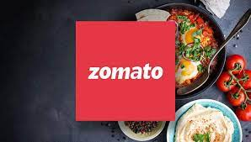
ZOMATO RESTAURANT ANALYSIS
Core Team
Group 1

Slide 2
Introduction
Zomato was founded by Deepinder Goyal and Pankaj Chaddah in 2008. Zomato provides information, menus and user-reviews of restaurants as well as food delivery options from partner restaurants in more than 1,000 Indian cities and towns, as of 2022–23. Zomato rivals Swiggy in food delivery and hyperlocal space.
The main work of Zomato is to suggest local and nearby restaurants to users and receive orders from them. Users can place orders from their favorite restaurant based on ratings and reviews shared by previous customers.
Vision Statement
Better food for more people

Slide 3
Zomato Summery
Zomato provides information, menus and user-reviews of restaurants as well as food delivery options from partner restaurants in more than 15 countries over 9551 restaurants. This project has helped us understand the model on which the Zomato works and factors in all the inputs to give out optimal suggestions to customer who love to place order or book a table.
We worked on various parameters provided to us and then dissected them to get necessary ingredients which helped us making a scrumptious dashboard. The insights provided shows that the Company operates a website and mobile app that provides in-depth information including menu, contact details, pictures, directions, ratings, and reviews for a multitude of restaurants.
Zomato Media extends its services throughout global networks. Zomato is a leading platform for restaurant search & discovery, online food ordering, and restaurant table reservations. Featuring a robust review system, Zomato allows foodies to find the best meals and restaurants in their neighborhood. A notable aspect about Zomato is that it is among the few companies that have gone global.

Slide 4
Technical Aspect
Data Source: The primary data source for this project is a dataset from Zomato, an online food delivery and restaurant discovery platform. This dataset includes information such as the number of restaurants, maximum ratings, distinct countries, maximum votes, Cuisines, countries, etc..
Key Performance Indicators (KPIs): The project focuses on several KPIs including the number of restaurants based on city and country, the number of restaurants opening based on year, quarter, and month, and the count of restaurants based on maximum rating. It also considers whether the restaurant has table booking and online booking facilities.
Data Analysis and Visualization : The most challenging task in this project was creating a calendar table using power query for data analysis and KPI’S, Visual Charts for visualization. Also include slicer and timeline using drilldown for Dynamic Dashboarding. Dax and power query for data manipulation and analysis in Power BI
Insights: The analysis provides key insights into popular countries, highest-rated restaurants, and customer preferences. These insights can be used by stakeholders to make informed decisions and strategies.

Slide 5
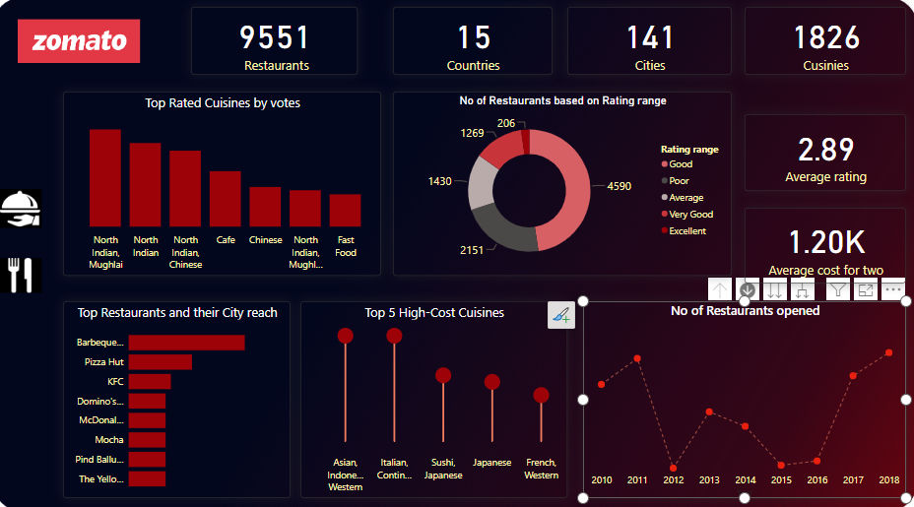
Insight Analysis
Total count of Restaurant : 9551
In which overall online Delivery is 26% and Table booking is 12 %.
Total cuisines : 9542 ,where more cuisines are in New Delhi i.e. 217.
Availability in 15 Countries , 141 Cities and 1265 locations.
Restaurant rating: poor , good, Very good, Average, Excellent wrt rate of restaurants where overall 2.14 % are rated as Excellent while 22.3% are rated as poor
year, month, Quarter wise opening :
Max Restaurant opened in year 2018 i.e. 1102 while Min are opened in 2012 i.e. 1022.
We can see North Indian Mughlai as top rated cuisine wrt Votes.

Slide 6
Conclusion
The insights that were provided helped us understand that how Zomato has entered market not only Locally but globally as well. It helps us figure out all that we need to order food or book a table as well as select the best restaurant with very good ratings so that we can get the best service Although Zomato has achieved a lot at a large front in past 2 decades, there still countries that do not use it to its optimal potential.
Zomato needs to consider that to expand it’s customer base in order to attract more customers They can try various new optimization that can help customers to ease their application experience

Slide 7
